Slide 1
Discussion 1B – Week 7

Slide 2
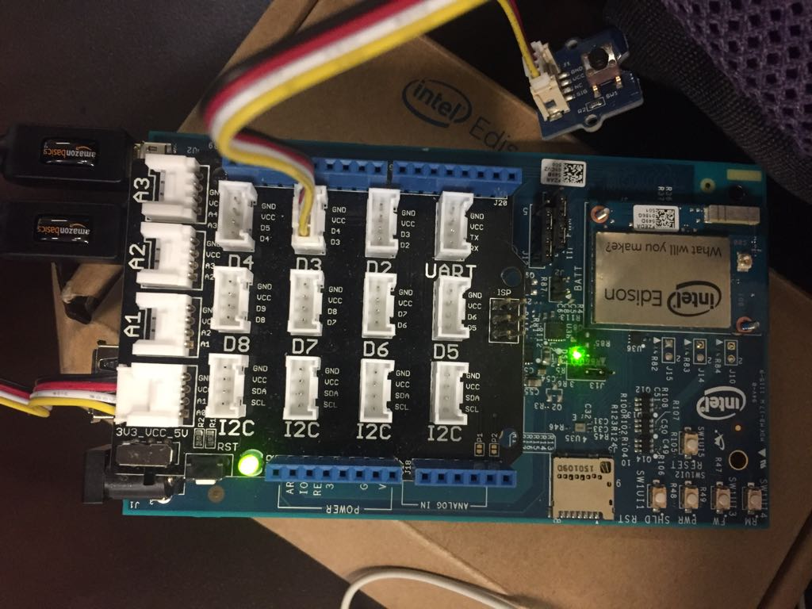
Connections

Slide 3
Things we will discuss
Go over connections.
MRAA library functions.
Grove temperature sensor and an Algorithm to convert the temperature reading.
Commands and the options.

Slide 4
MRAA library functions
mraa_gpio_context mraa_gpio_init ( int pin )
Initialise gpio_context, based on board number
Parameters
pin Pin number read from the board, i.e IO3 is 3
Returns
gpio context or NULL
mraa_result_t mraa_gpio_dir (mraa_gpio_context dev, mraa_gpio_dir_t dir )
et Gpio direction
Parameters
dev The Gpio context
dir The direction of the Gpio
Returns
Result of operation

Slide 5
int mraa_gpio_read ( mraa_gpio_context dev )
Read the Gpio value. This can be 0 or 1. A resonse of -1 means that there was a fatal error.
Parameters
dev The Gpio context
Returns
Result of operation
mraa_result_t mraa_gpio_close(mraa_gpio_context dev)
Close the Gpio context.
Will free the memory for the context and unexport the Gpio
Parameters
dev The Gpio context
Returns
Result of operation

Slide 6
mraa_aio_context mraa_aio_init ( unsigned int pin
Initialise an Analog input device, connected to the specified pin
Parameters
pin Channel number to read ADC inputs
Returns
aio context or NULL
int mraa_aio_read ( mraa_aio_context dev )
Read the input voltage. By default mraa will shift the raw value up or down to a 10 bit value.
Parameters
dev The AIO context
Returns
The current input voltage or -1 for error

Slide 7
mraa_result_t mraa_aio_close ( mraa_aio_context dev )
Close the analog input context, this will free the memory for the context
Parameters
dev The AIO context
Returns
Result of operation

Slide 8
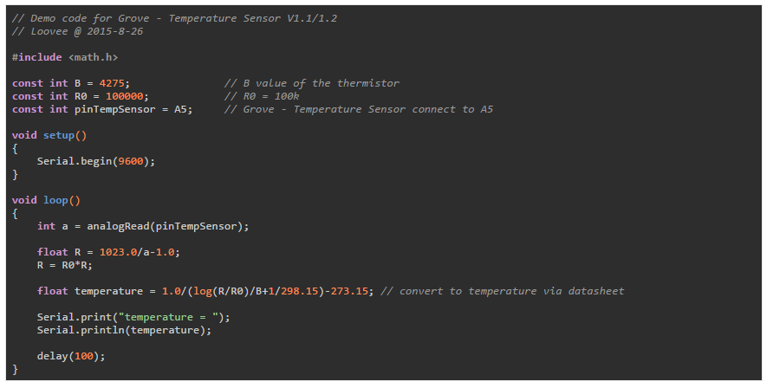
Grove temperature sensor
Should be using mraa_aio_read() instead of analogRead()

Slide 9
Commands and Options
--scale=C
--period=#
--log=filename
OFF, STOP, START.

